Slide 1
Chapter 9 Morphological Image Processing

Slide 2
9.1 Preliminaries
Reflection of set B
Translation of set B

Slide 3
Structuring Elements

Slide 4
9.2 Erosion and Dilation
9.2.1 Erosion

Slide 5
9.2.1 Erosion

Slide 6
9.2.1 Erosion
[Programming]

Slide 7
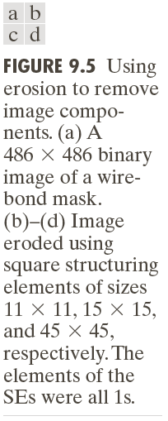
9.2.1 Erosion

Slide 8
9.2.1 Erosion
Result of Erosion
Shrink
Smooth Boundary
Remove thin lines and small region

Slide 9
9.2 Erosion and Dilation
9.2.2 Dilation
A(+)B={z|(B)z∩A≠φ}

Slide 10
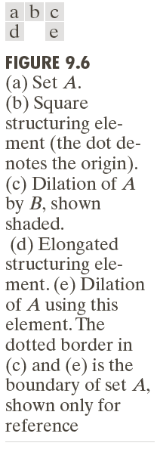
9.2.2 Dilation

Slide 11
9.2.2 Dilation
[Programming]

Slide 12
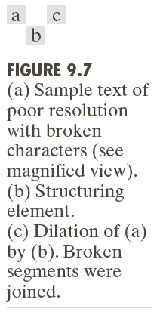
9.2.2 Dilation
9.2.2 Dilation

Slide 13
9.2.2 Dilation
Result of Dilation
Expand
Smooth Boundary
Remove thin rift and small hole

Slide 14
9.3 Open and Close
Open: A(-)B(+)B
Close: A(+)B(-)B

Slide 15
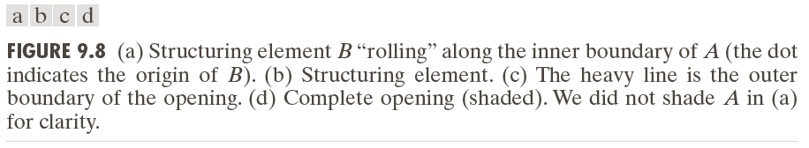
9.3 Open and Close
Convex corner

Slide 16
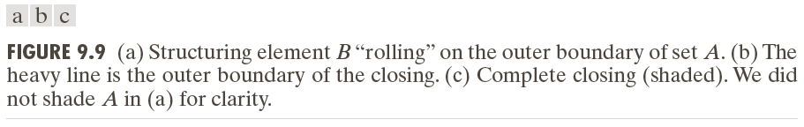
9.3 Open and Close
Concave corner

Slide 17
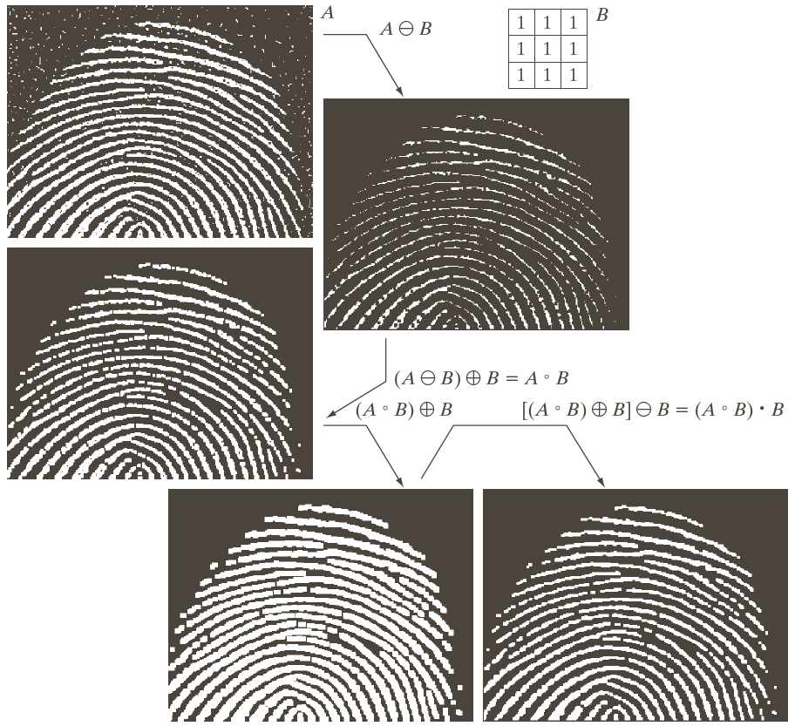
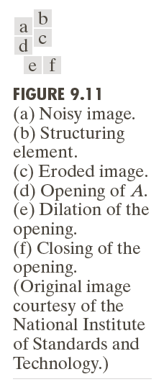
9.3 Open and Close

Slide 18
Exercise

